Slide 1
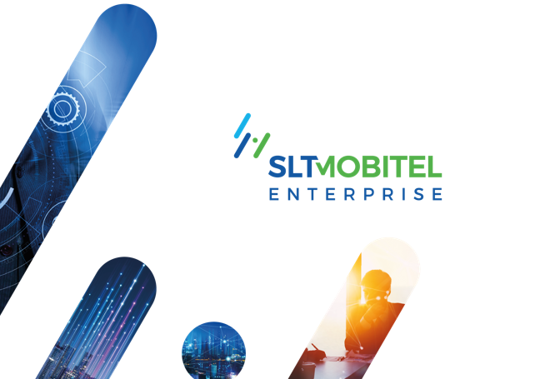


Slide 2
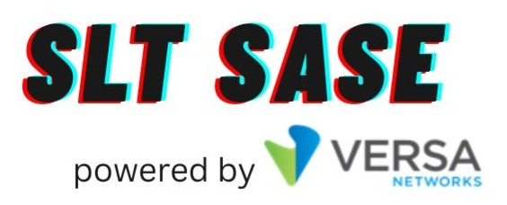
Secure Everything.
Connect Everywhere.

Slide 3
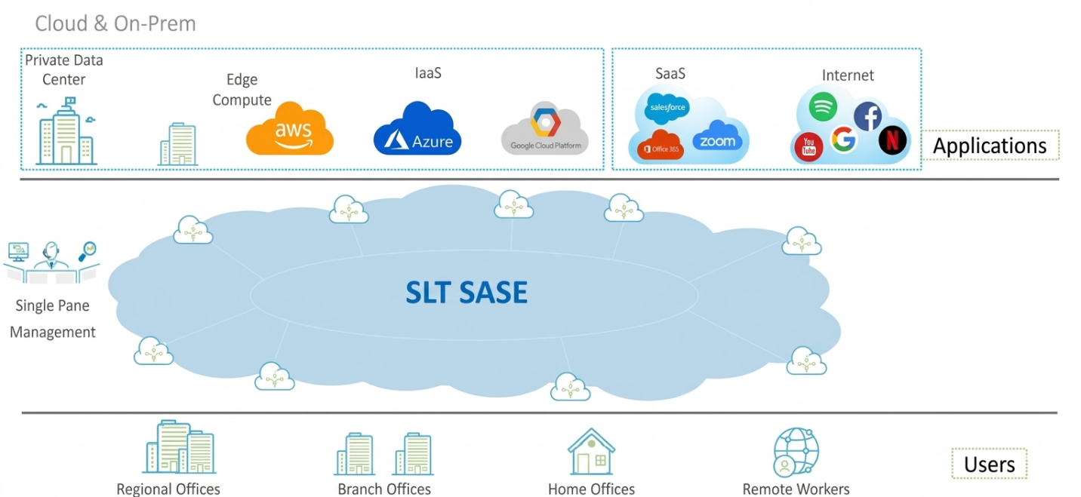
SLT SASE Product
SLT SASE delivers secure, simplified, and fully managed networking—empowering businesses to connect and protect everything, everywhere.

Slide 4
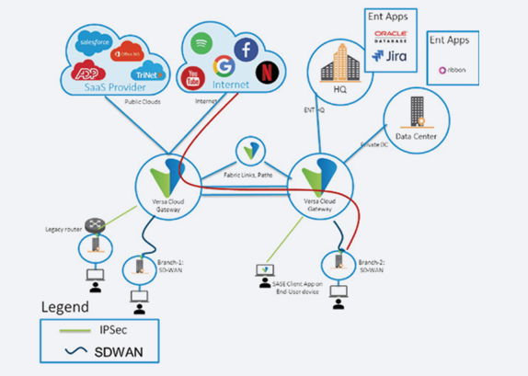
SLT SASE Solution Architecture

Slide 5
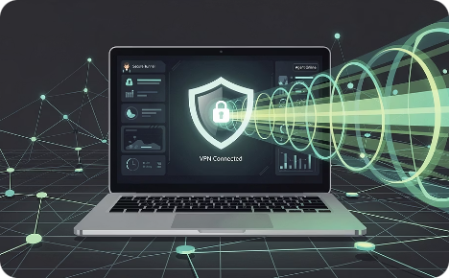
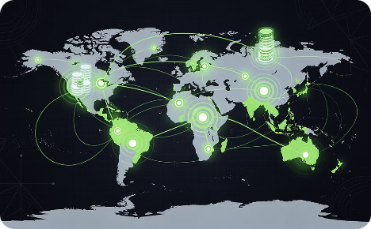
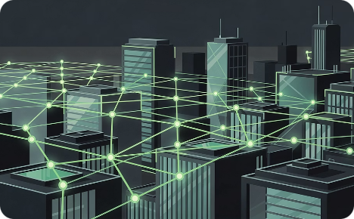
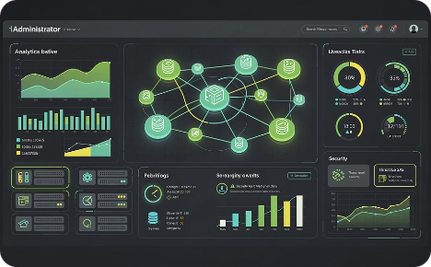
SLT SASE Components
SASE Client
Cloud Gateways
SASE Fabric
Connects all cloud gateways together
Ensures fast, reliable, and optimized traffic flow
Delivers a smooth user experience across locations
SASE Portal
Central dashboard for IT teams
Monitor, manage, and control everything in one place
Provides visibility on users, apps, and network activity
Installed on user devices (laptop/mobile)
Creates a secure, encrypted connection to the cloud
Allows safe access to company apps from anywhere
Cloud-based secure entry points
Authenticate users & control access
Protect against threats while connecting to apps and data

Slide 6
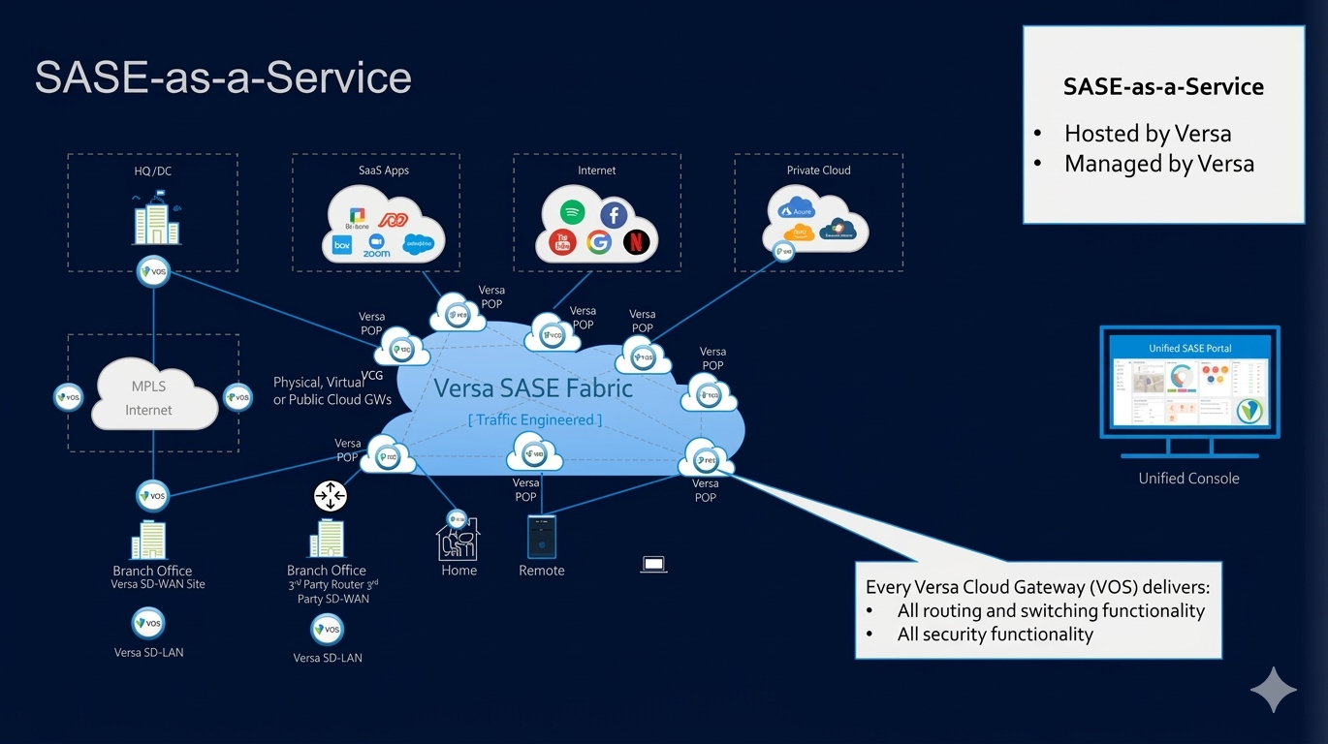
SLT SASE Business Models
1. SASE as-a-Service Model
This is a fully cloud-delivered and fully managed SASE deployment model that enables rapid service rollout, elastic scalability, and simplified operations for customers.

Slide 7
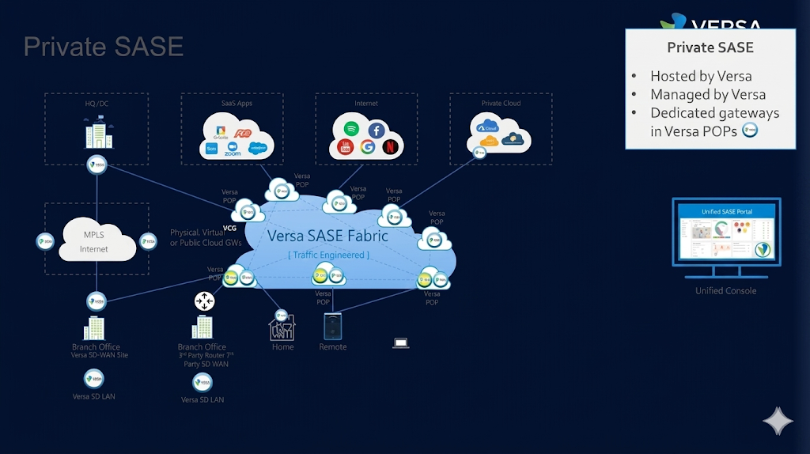
SLT SASE Business Models
2.Private SASE Model
Sovereign SASE Model. Gateways are locally hosted.

Slide 8
SLT SASE Features
1. FWaaS (Firewall-as-a-Service)
2. SWG (Secure Web Gateway)
3. CASB (Cloud Access Security Broker)
4. ZTNA (Zero Trust Network Access)
5. DLP (Data Loss Prevention)
6. RBI (Remote Browser Isolation)
7. Advanced Threat Protection (ATP)
8. Compatible with SD-WAN

Slide 9
SLT SASE Services
SLT SASE Services ensure secure access to both internal applications and the internet—protecting users wherever they work.
🔐 Secure Private Access
Provides safe access to internal company applications
Uses Zero Trust – only authorized users can connect
Access is controlled based on user, device, and location
Keeps sensitive business data secure and protected
🌐 Secure Internet Access
Protects users from internet threats (viruses, malware, ransomware)
Secures access to websites and cloud applications (SaaS)
Applies smart security controls based on user and device
Prevents data leaks and unauthorized access

Slide 10
SLT SASE Licensing Models (Packages)
Based on these SLT SASE services there are 3 SLT SASE licensing models.
1.SASE Trust
Secure Private Access License model.
Secure access to internal apps.
2. SASE Secure
Secure Internet Access License model.
Protect internet & users
3. SASE Fabric 361
Secure Access Fabric License model.
Secure both internet access & private access.
A unified, intelligent security fabric that goes beyond traditional boundaries (Connect all user branches and application in one single platform )
3 + 6 + 1 concept
3 → Network + Security + Access
6 → Key security layers (NGFW, SWG, CASB, ZTNA, DLP, ATP)
1 → Unified platform

Slide 11
SLT SASE Licensing Models-Feature Mapping
Capability | SASE Trust | SASE Secure | SASE Fabric 361
Main Purpose | Secure internal applications | Secure internet & SaaS access | Complete security + networking
User Access Type | 👤 Internal apps only | 🌐 Internet & cloud apps | 👤 + 🌐 Both (full access)
Zero Trust (ZTNA) | ✅ Yes | ❌ No | ✅ Yes
Secure Web Gateway (SWG) | ❌ No | ✅ Yes | ✅ Yes
CASB (Cloud App Control) | ❌ No | ✅ Yes | ✅ Yes
Firewall (FWaaS) | ⚠️ Limited | ✅ Yes | ✅ Yes
Data Loss Prevention (DLP) | ⚠️ Limited | ✅ Yes | ✅ Yes
Advanced Threat Protection (ATP) | ⚠️ Basic | ✅ Yes | ✅ Yes
Remote Browser Isolation (RBI) | ❌ No | ✅ Yes | ✅ Yes
Access to Private Apps (DC/Cloud) | ✅ Yes | ❌ No | ✅ Yes
Access to Internet / SaaS | ❌ No | ✅ Yes | ✅ Yes
Unified Platform (Single Pane) | ❌ Partial | ❌ Partial | ✅ Full
Best For | Remote VPN Replacement | Internet security | Full SASE transformation

